Slide 1
Week 07 Solution
Stacey Wang

Slide 2


Problem1
Greeks for Call
Greeks for Put

Slide 3
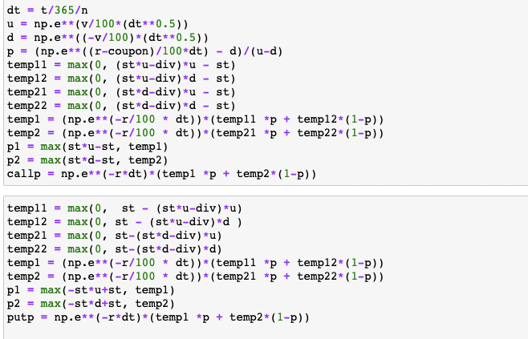

Problem1
Binomial Tree Algorithm in Python:
Call & Put price (respectively):

Slide 4
Problem1
Conclusion
Put options become more expensive since the price will drop by the amount of the dividend
Call options become cheaper due to the anticipated drop in the price of the stock
The value of put option respond less than call option to a price change as the absolute value of delta(put) < delta(call)

Slide 5

Problem3
Expected return:

Slide 6

Problem3
Optimized efficient portfolio weights for 20 stocks:

